Slide 1
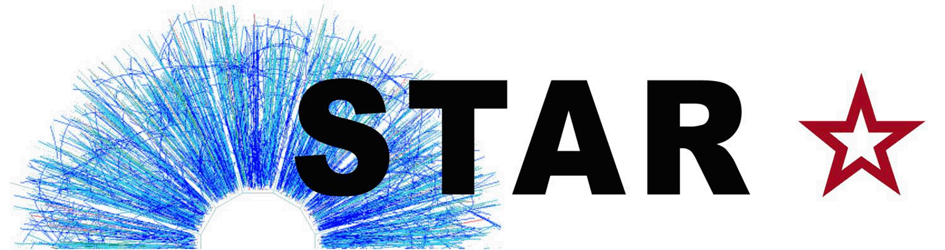



Charm Quark Jets in Au+Au Collisions at $\sqrt{s_{NN}}$ = 200 GeV
STAR Collaboration Meeting
February 28, 2023
Diptanil Roy
Rutgers University
roydiptanil@gmail.com
Supported in part by

Slide 2
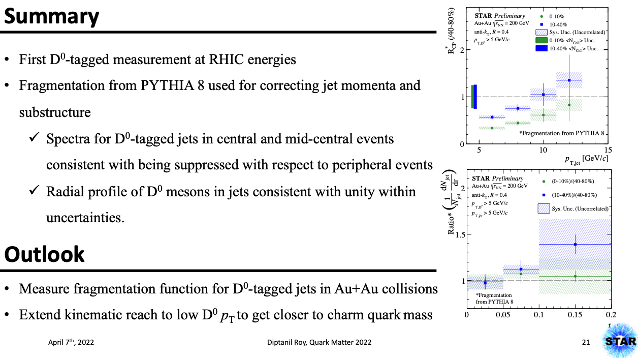
Recap
ISSUES
1. Fragmentation function for PYTHIA is ‘too’ hard for the full range of D0 pT
2. For low D⁰ p_{T} in jets, unfolding is dependent on the fragmentation function
Details here: https://drupal.star.bnl.gov/STAR/system/files/Kelsey_JetCorr_17Mar2022.pdf

Slide 3
Issues with simulation
DCA < 3.0 cm
nHitsFit > 15
nHitsRatio > 0.52
DCA cuts were not applied to the detector level tracks
Multiple detector level tracks → Matched to 1 generated track
Not accounted for earlier
Gen Tracks with > 1 reco track matched
Min DCA vs Max DCA for gen tracks with > 1 matches
Reco Track with lowest DCA is chosen as the matched track

Slide 4
Issues with simulation
DCA < 3.0 cm
nHitsFit > 15
nHitsRatio > 0.52
DCA cuts were not applied to the detector level tracks
Multiple detector level tracks → Matched to 1 generated track
Not accounted for earlier
Input Reco Tracks for JetMaker
Reco Jet pT in pp

Slide 5

Issues with simulation
DCA < 3.0 cm
nHitsFit > 15
nHitsRatio > 0.52
DCA cuts were not applied to the detector level tracks
Multiple detector level tracks → Matched to 1 generated track
Not accounted for earlier
Input Reco Tracks for JetMaker
Reco Jet pT in pp
Different Jet pT distributions → Changes in response matrix

Slide 6
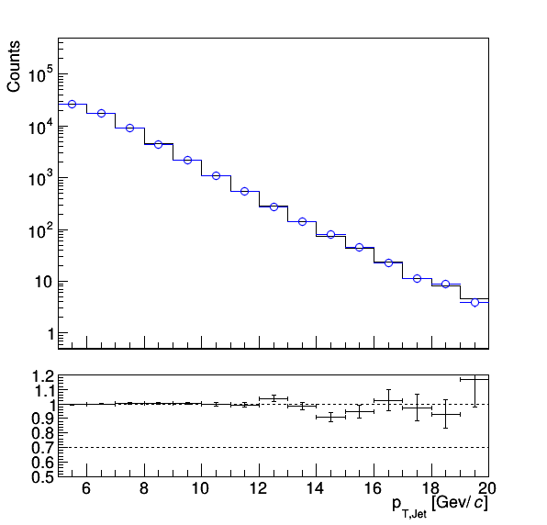
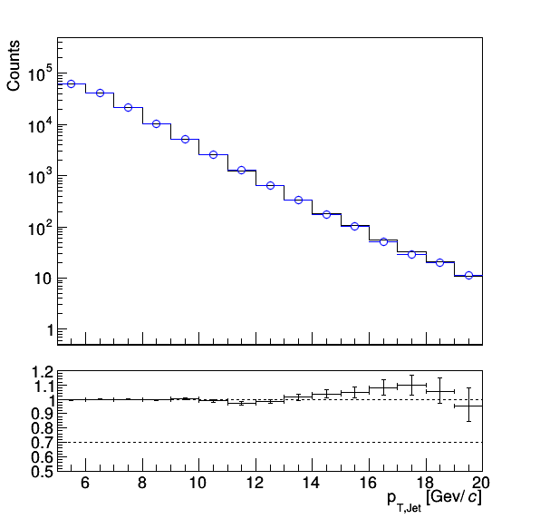
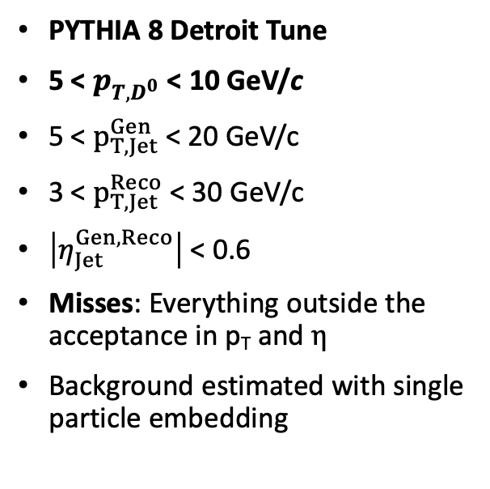
Revisiting 1D Unfolding Closure
PYTHIA 8 Detroit Tune
5 < $p_{T,D^{0}}$ < 10 GeV/c
5 < $p_{T,Jet}^{Gen}$ < 20 GeV/c
3 < $p_{T,Jet}^{Reco}$ < 30 GeV/c
$\left|η_{Jet}^{Gen, Reco}\right|$ < 0.6
Misses: Everything outside the acceptance in p_{T} and $η$
Background estimated with single particle embedding
All centralities close well with new response matrices

Slide 7
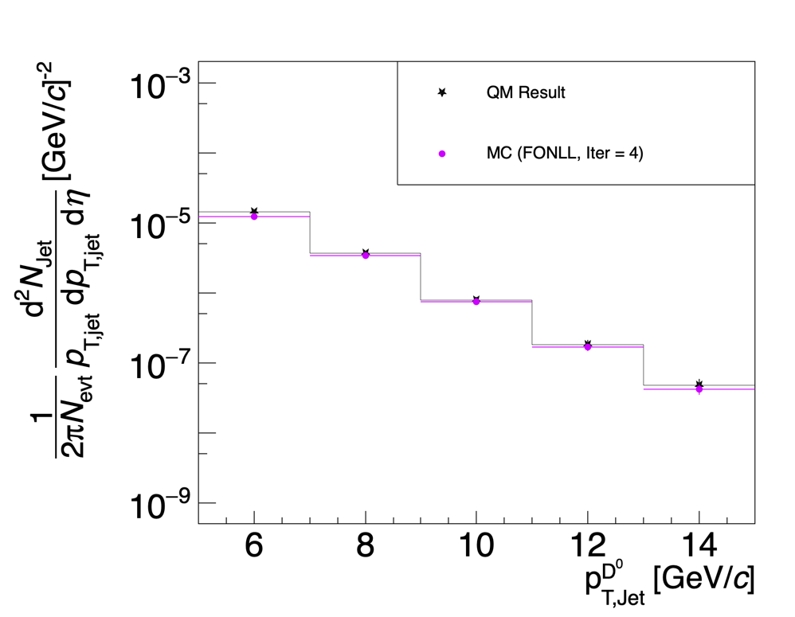
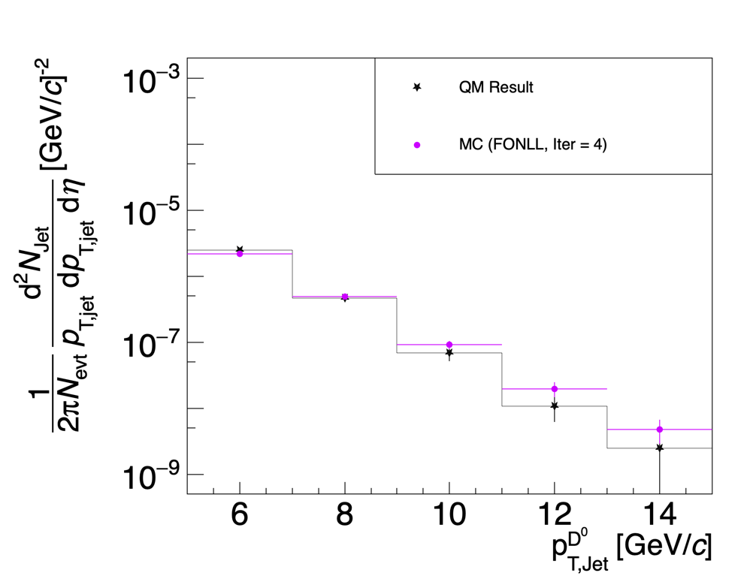
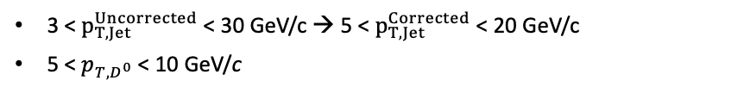
Revisiting Data
3 < $p_{T,Jet}^{Uncorrected}$ < 30 GeV/c → 5 < $p_{T,Jet}^{Corrected}$ < 20 GeV/c
5 < $p_{T,D^{0}}$ < 10 GeV/c

Slide 8
Revisiting Data
3 < $p_{T,Jet}^{Uncorrected}$ < 30 GeV/c → 5 < $p_{T,Jet}^{Corrected}$ < 20 GeV/c
5 < $p_{T,D^{0}}$ < 10 GeV/c
Peripheral spectra shifts significantly from QM

Slide 9
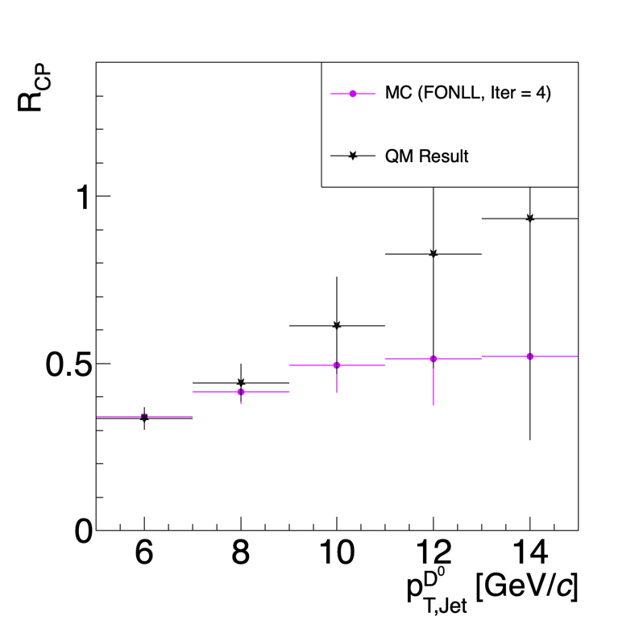
Revisiting Data
3 < $p_{T,Jet}^{Uncorrected}$ < 30 GeV/c → 5 < $p_{T,Jet}^{Corrected}$ < 20 GeV/c
5 < $p_{T,D^{0}}$ < 10 GeV/c
Peripheral spectra shifts significantly from QM
Rise of RCP with Jet pT less steep after corrections

Slide 10
Updating the simulation
Earlier, single particle embedded in minimum bias event to determine background fluctuation
Minimum Bias Event (x1)
Process MB + PYTHIA tracks together
Detector Level Jets
Background Subtraction on tracks from MB only
Compare Particle Level Jets with Detector Level Jets
PYTHIA + GEANT3 Event
Particle Level Jets
Get a minimum bias event
Sample a PYTHIA event for each minimum bias event
Run jet maker on the PYTHIA events ‘embedded’ in the minimum bias event -> This is PARTICLE level
Run jet maker on the combined PYTHIA + Minbias event -> This is DETECTOR level
Each PYTHIA event is sampled ~10 times on average

Slide 11
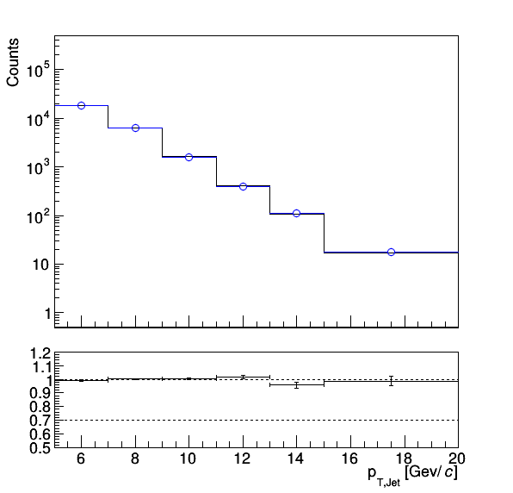
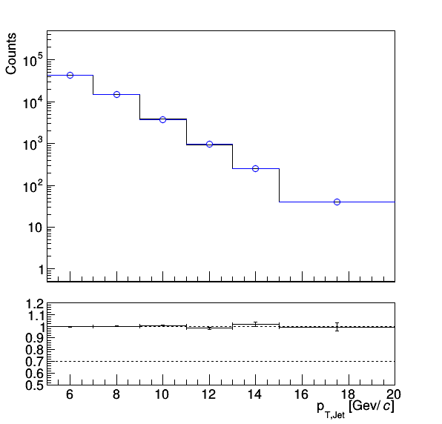
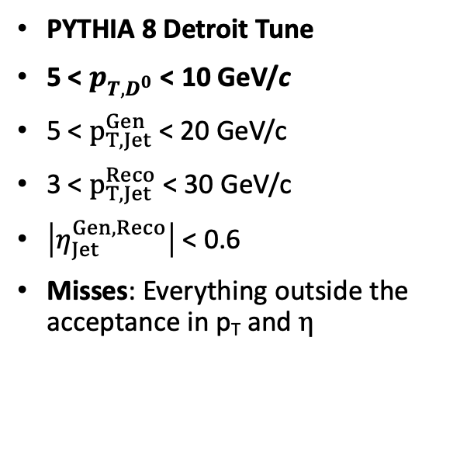
Closure with Heavy Ion Overlay for 1D Unfolding
PYTHIA 8 Detroit Tune
5 < $p_{T,D^{0}}$ < 10 GeV/c
5 < $p_{T,Jet}^{Gen}$ < 20 GeV/c
3 < $p_{T,Jet}^{Reco}$ < 30 GeV/c
$\left|η_{Jet}^{Gen, Reco}\right|$ < 0.6
Misses: Everything outside the acceptance in p_{T} and $η$
All centralities close well with the HI Overlay Method

Slide 12
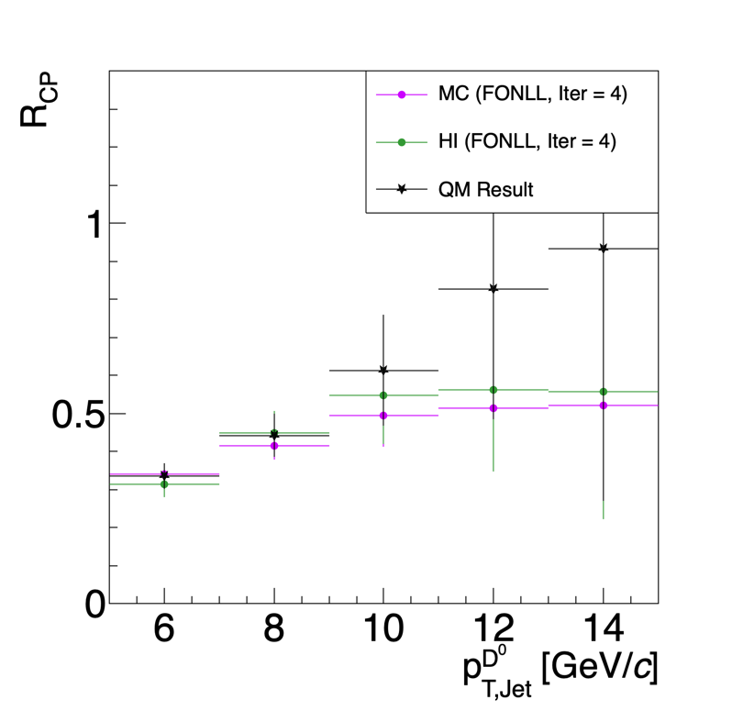
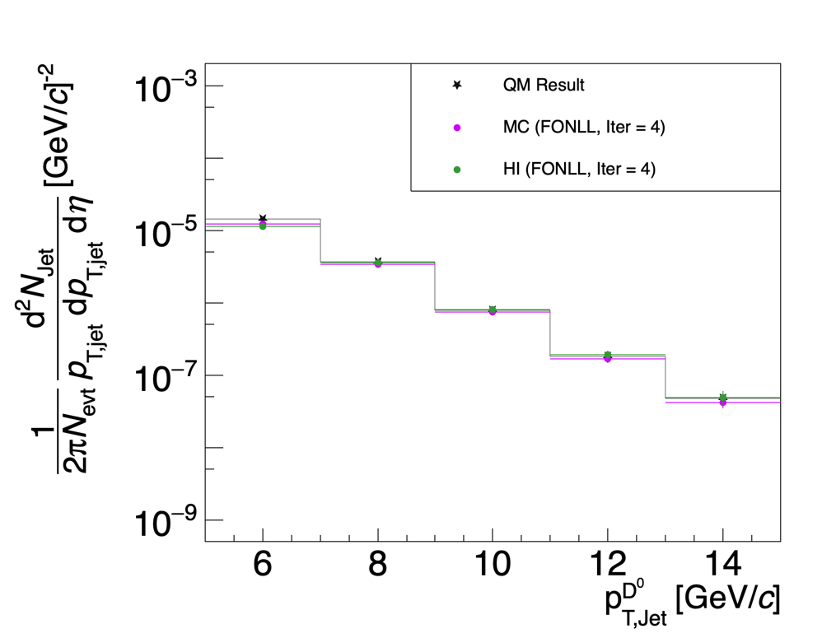
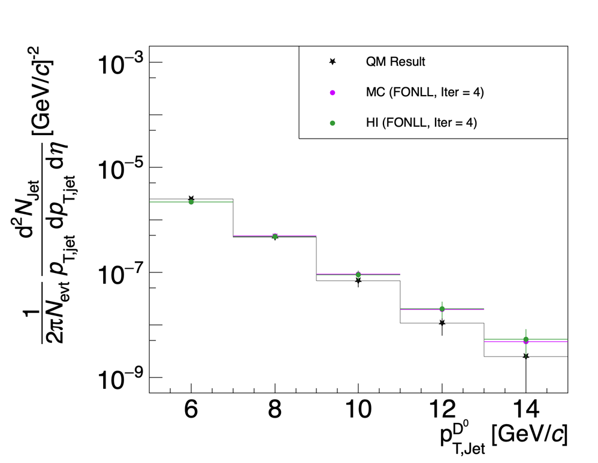
Unfolding Data With HI Overlay
3 < $p_{T,Jet}^{Uncorrected}$ < 30 GeV/c → 5 < $p_{T,Jet}^{Corrected}$ < 20 GeV/c
5 < $p_{T,D^{0}}$ < 10 GeV/c
Slight differences in spectra – Good overall agreement

Slide 13
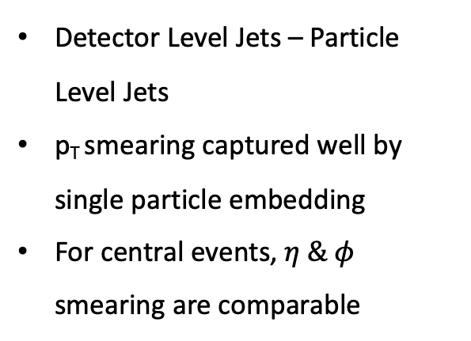
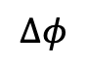
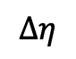
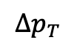
Unpacking the differences between HI Overlay and Single Particle Embedding
$$Δp_{T}$$
$$Δη$$
$$Δφ$$
Central
Detector Level Jets – Particle Level Jets
p_{T} smearing captured well by single particle embedding
For central events, $η \& φ$ smearing are comparable
Peripheral
Reco Jets in HI Overlay for peripheral events have larger smearing in $η, φ$

Slide 14
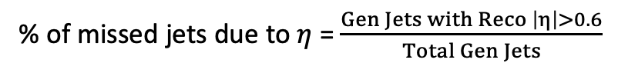

Unpacking the differences between HI Overlay and Single Particle Embedding
Example of effect of different $η$ smearing
% of missed jets due to $η$ = $\frac{Gen Jets with Reco \left|η\right|>0.6}{Total Gen Jets}$
~2% difference in central events
~1% difference in peripheral events
Small differences between HI and Single Particle Embedding can be attributed to the $η$ smear.
HI is more reliable (?)

Slide 15
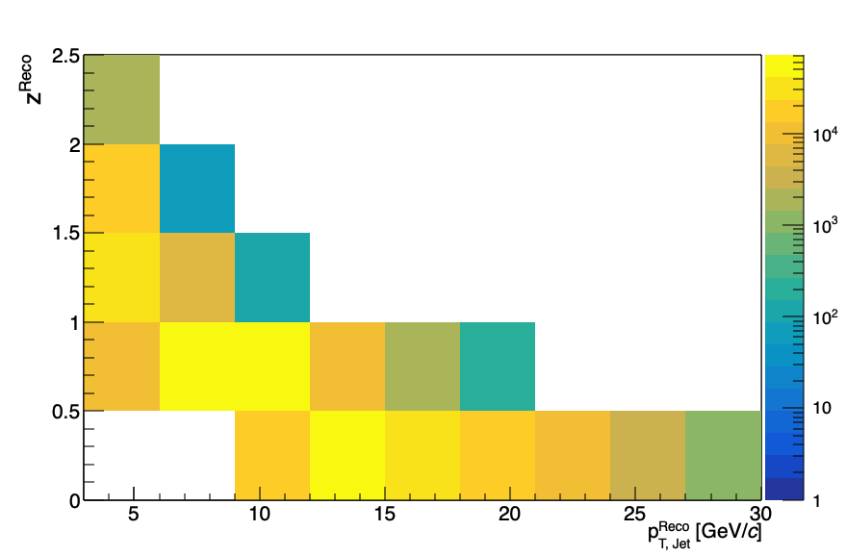
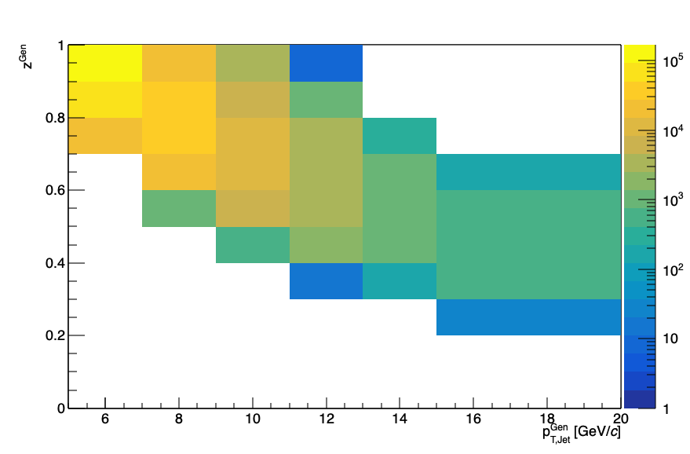
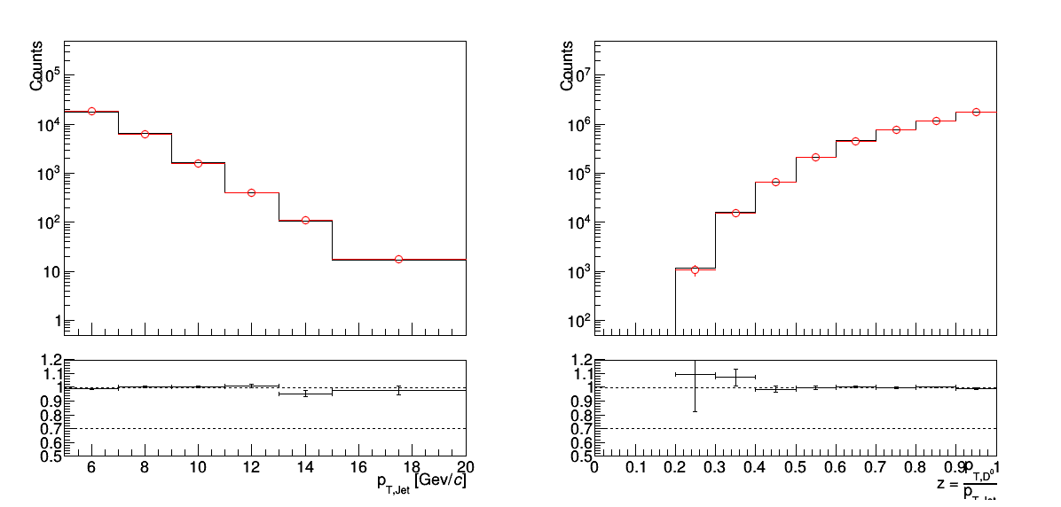
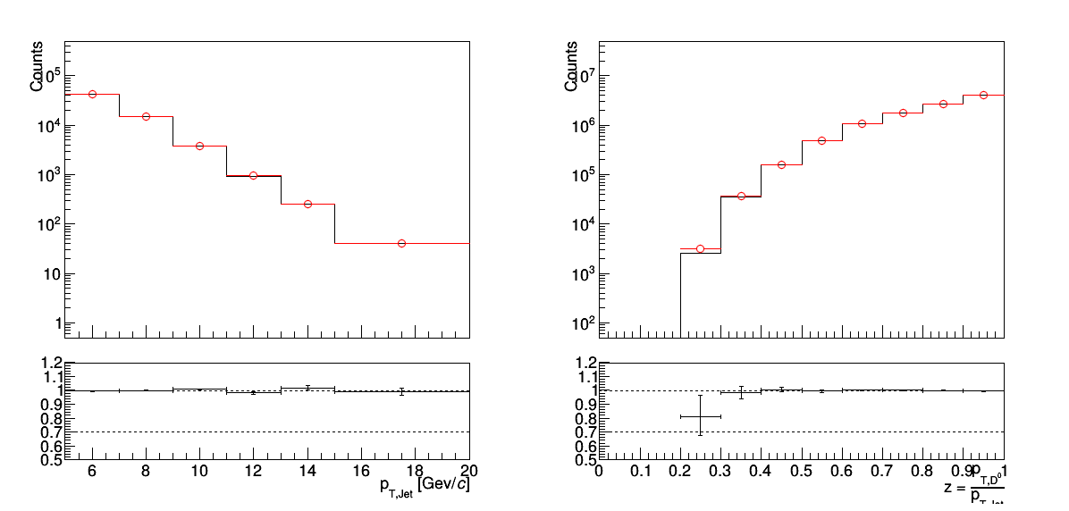
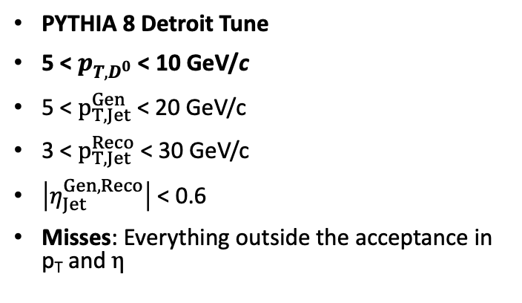
Closure For 2D Unfolding Using HI Overlay
Detector Level
Particle Level
PYTHIA 8 Detroit Tune
5 < $p_{T,D^{0}}$ < 10 GeV/c
5 < $p_{T,Jet}^{Gen}$ < 20 GeV/c
3 < $p_{T,Jet}^{Reco}$ < 30 GeV/c
$\left|η_{Jet}^{Gen, Reco}\right|$ < 0.6
Misses: Everything outside the acceptance in p_{T} and $η$
Jet pT and Fragmentation function close simultaneously using HI Overlay

Slide 16
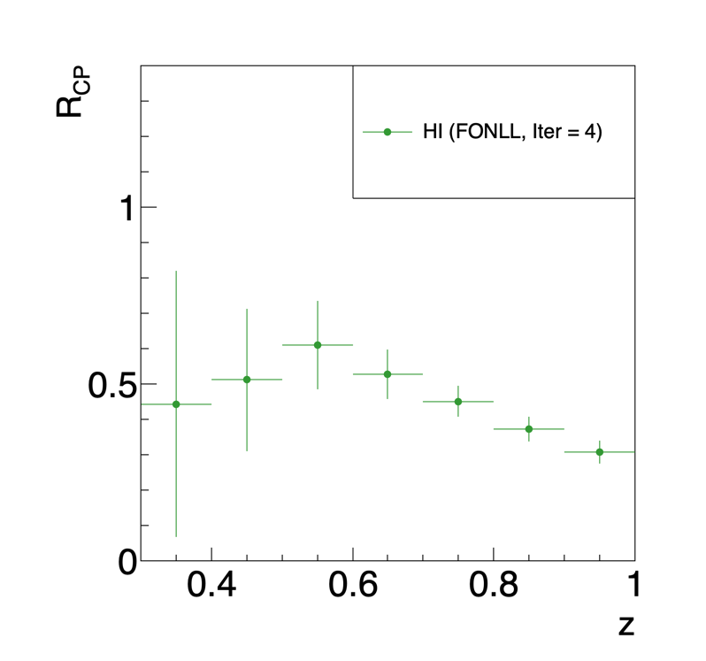
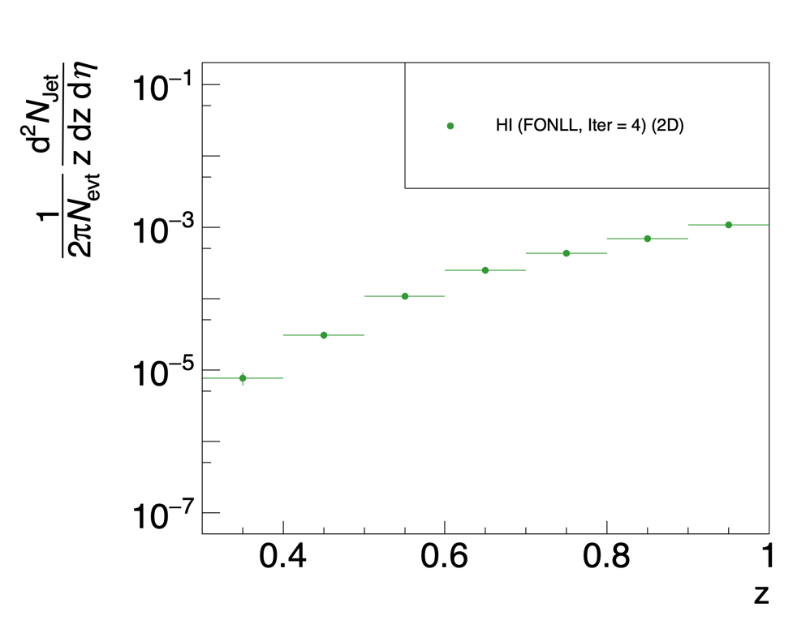
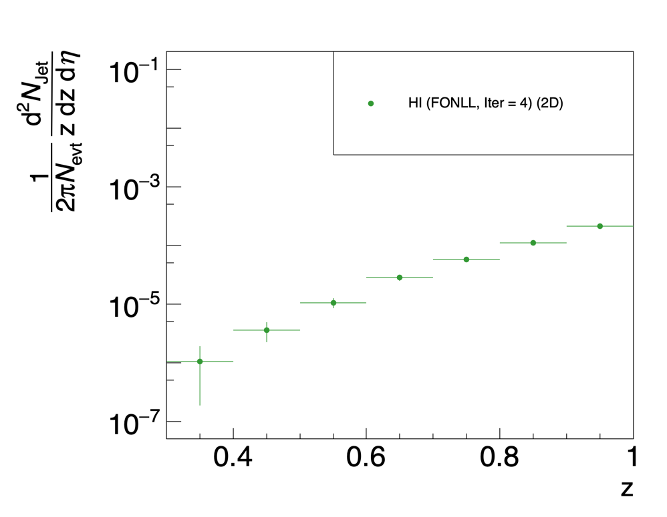
FIRST LOOK
Fragmentation Function From Data – Unfolding using HI
3 < $p_{T,Jet}^{Uncorrected}$ < 30 GeV/c → 5 < $p_{T,Jet}^{Corrected}$ < 20 GeV/c
5 < $p_{T,D^{0}}$ < 10 GeV/c
Unfolded Fragmentation With PYTHIA (FONLL) Prior for high pT D⁰ in Jets.
Theory suggestions for comparison are welcome.

Slide 17
Summary
Changed preliminary spectra due to missed track QA cuts in QM results.
Heavy-Ion Overlay is a viable alternative for unfolding.
Results from HI and SP Embedding have pretty good agreement.
HI gives us enough stats to attempt 2D unfolding in Jet pT and z axis.
First look at the unfolded z spectra and RCP.
Outlook
Extending to D0 pT > 1 GeV/c, where PYTHIA prior is possibly incorrect.
Theory expectations for RCP of fragmentation functions (?)

Slide 18
BACKUP

Slide 19

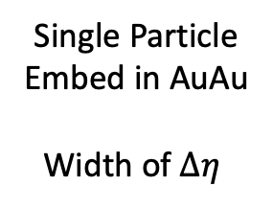
$η$ smearing steps in simulation
pp Simulation
X
Final $Δη$ in AuAu
Single Particle
Embed in AuAu
Width of $Δη$

Slide 20
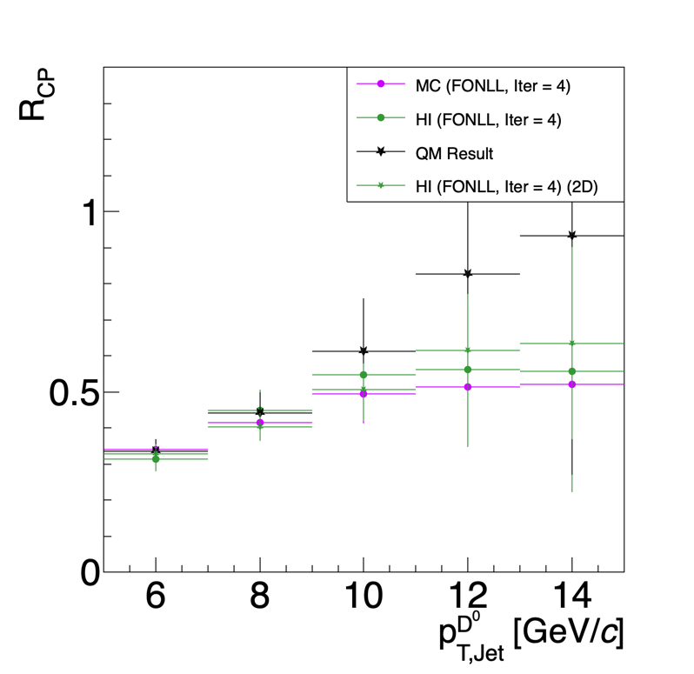
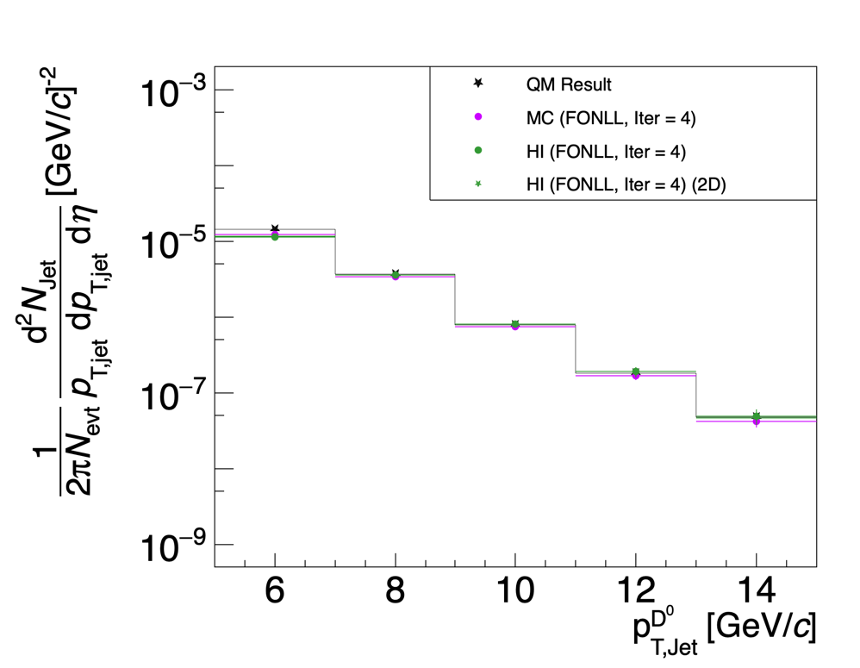
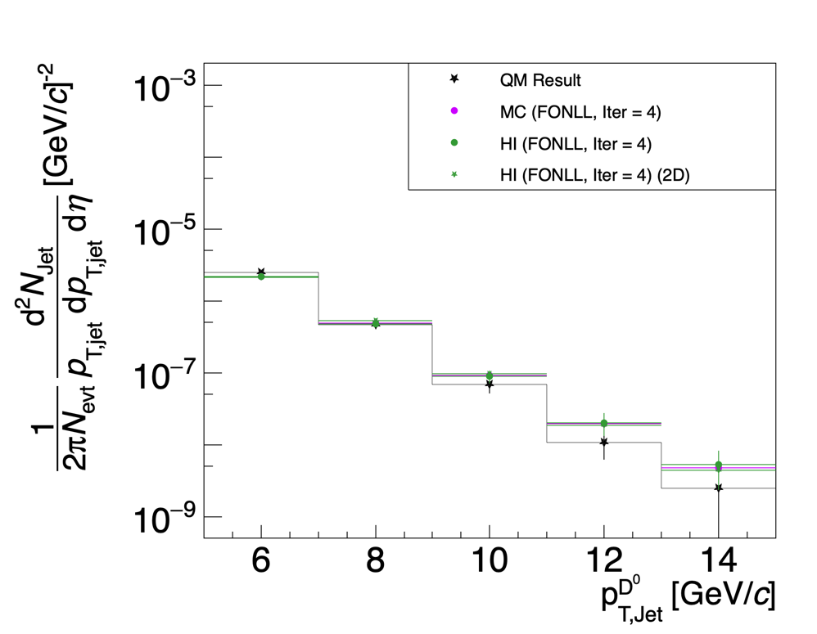
Unfolding Data With HI Overlay (Includes the plot from 2D Unfolding of Jet pT)
3 < $p_{T,Jet}^{Uncorrected}$ < 30 GeV/c → 5 < $p_{T,Jet}^{Corrected}$ < 20 GeV/c
5 < $p_{T,D^{0}}$ < 10 GeV/c
Slight differences in spectra – Good overall agreement

Slide 21
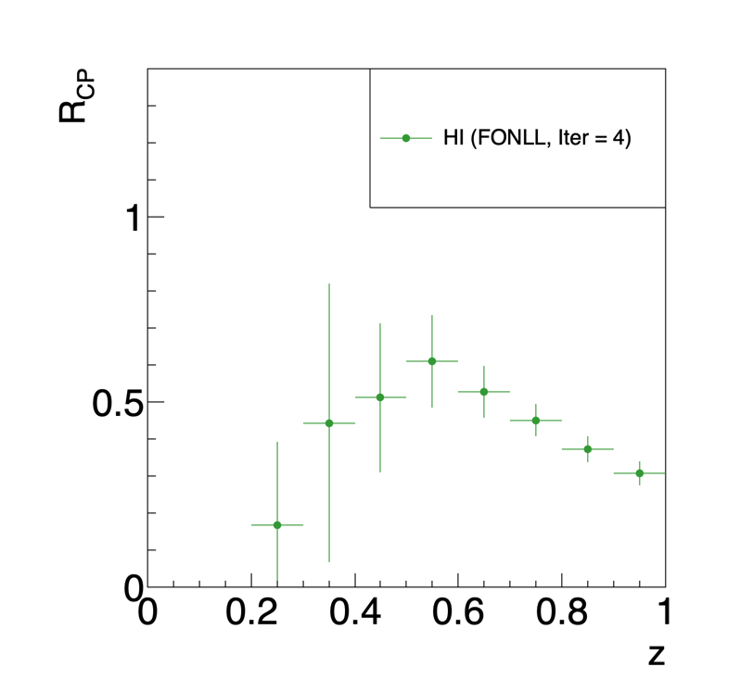
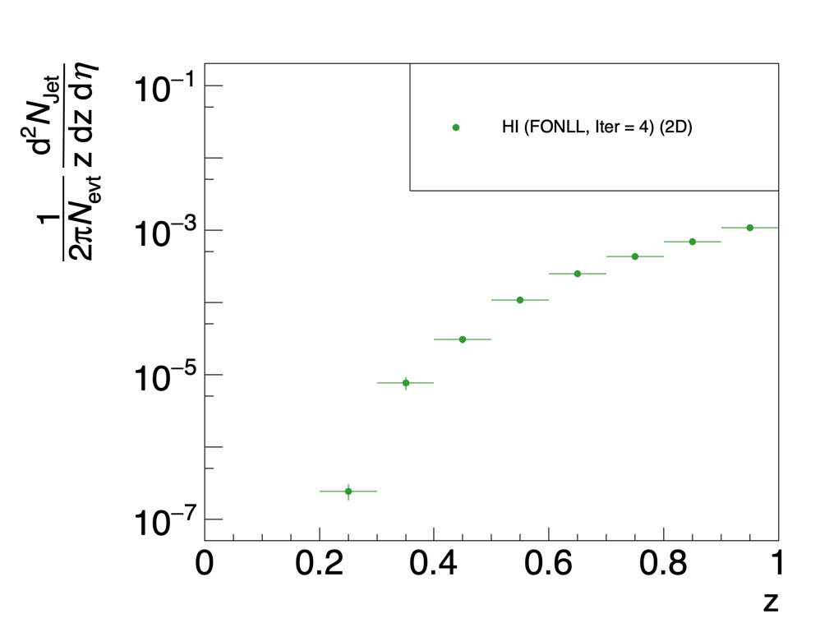
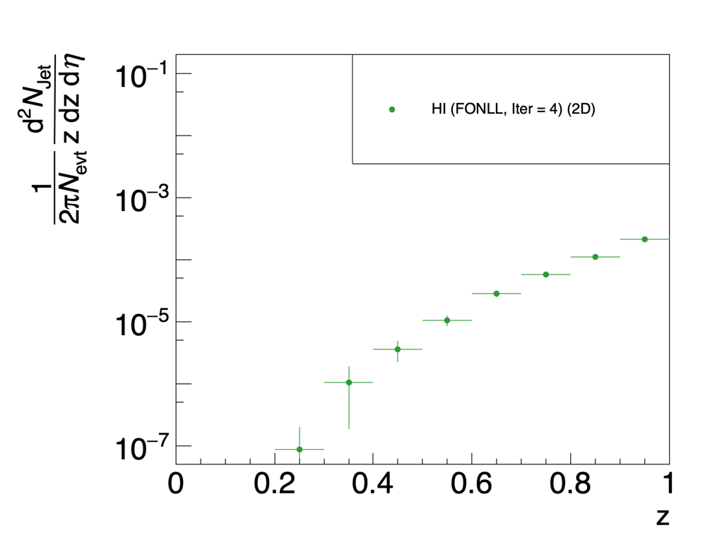
FIRST LOOK
Fragmentation Function From Data – Unfolding using HI (z $∈$ [0, 1])
3 < $p_{T,Jet}^{Uncorrected}$ < 30 GeV/c → 5 < $p_{T,Jet}^{Corrected}$ < 20 GeV/c
5 < $p_{T,D^{0}}$ < 10 GeV/c
Unfolded Fragmentation With PYTHIA (FONLL) Prior for high pT D⁰ in Jets.
Theory suggestions for comparison are welcome.

